Slide 1

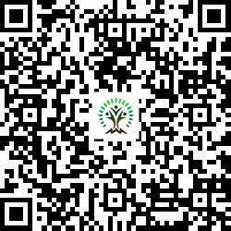


IONIQ Forest
Grid – D Zones 1 -10

Slide 2
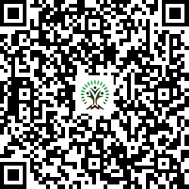
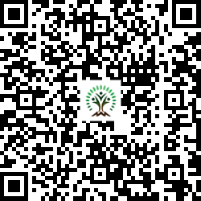
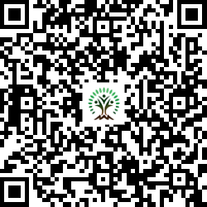
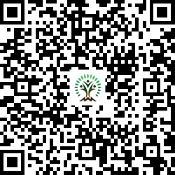
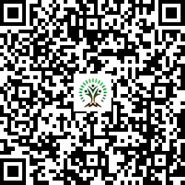
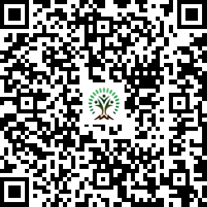
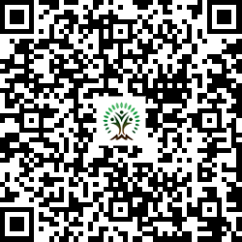
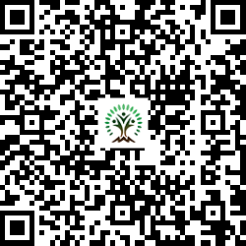
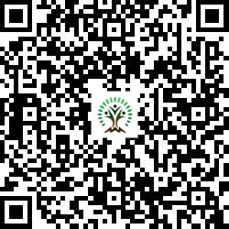
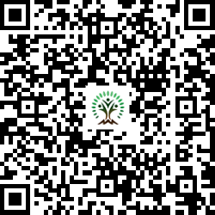
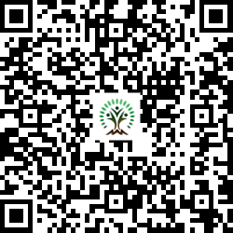
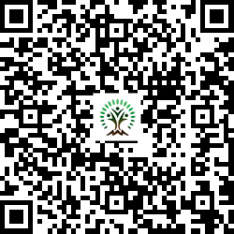
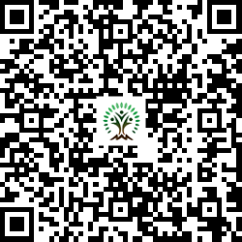
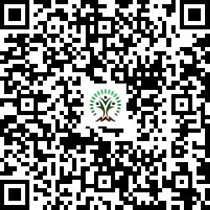
Sr. No. | Scientific Name | Common Name | QR Code
1 | Adenanthera pavonina | Red Sandalwood
2 | Aegle marmelos | Wood Apple
3 | Azadirachta indica | Neem Tree
4 | Cassia fistula | Golden shower tree
5 | Dalbergia sissoo | Indian rosewood
6 | Lagerstroemia speciosa | Pride of India
7 | Mimusops elengi | Spanish cherry
Sr. No. | Scientific Name | Common Name | QR Code
8 | Morus nigra | mulberry
9 | Neolamarckia cadamba | Burrflower tree
10 | Phyllanthus emblica | Indian gooseberry
11 | Pongamia pinnata | Indian Beech Tree
12 | Psidium guajava | Guava
13 | Schleichera oleosa | Gum lac tree
14 | Syzygium cumini | Java plum, Jamun

Slide 3
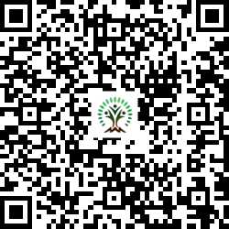
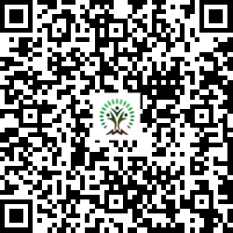
Sr. No. | Scientific Name | Common Name | QR Code
15 | Terminalia arjuna | White Murdah
16 | Toona ciliata | Indian mahogany

